Slide 1
story 5
File created on: 10/30/2023 5:06:58 AM

Slide 2
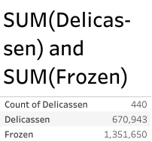

Slide 3
